Slide 1
The major updates in thyroid pathology tumor classification by the who 5th edition
Vania Nosé, MD, PhD
Massachusetts General Hospital and Harvard Medical School

Slide 2
Declaração de Conflito de Interesse
Dra. Vania Nosé afirma ter / não ter conflito de interesse a declarar
Em caso afirmativo, especificar: associação financeira relevante nos últimos 12 meses e que esteja relacionada ao conteúdo da atividade científica
Exigência da RDC Nº 96/08 da ANVISA

Slide 3
Endocrine Pathology Program:
The major updates in thyroid pathology tumor classification by the WHO 5th edition: Vania Nosé
Implications of the new classification in thyroid cytology diagnosis: Mauro Saieg
The refashioned benign thyroid tumors: Clovis Klock
15h30 - 16h00 Coffee Break
The new benign oncocytic thyroid tumors: Sule Canberk Schmitt
The new follicular cell-derived thyroid tumors: Vania Nosé
The refashioned malignant oncocytic thyroid tumors: Sule Canberk Schmitt
17h20 - Book SORTEIO!!!!

Slide 4
The Major Updates In Thyroid Pathology Tumor Classification

Slide 5
5th Edition WHO Classification of Endocrine and Neuroendocrine Tumors WHO Blue Book Online
tumourclassification.iarc.who.int

Slide 6
5th Edition WHO Classification of Endocrine and Neuroendocrine Tumors: Goal
To improve patient care and cancer prevention, by producing a definitive, evidence-based classification of all tumor types, to enable diagnosis and research worldwide

Slide 7
5th Edition WHO Classification of Endocrine and Neuroendocrine Tumors
The new classification has divided thyroid tumors into several new categories that allow for a clearer understanding of:
Cell of origin
Pathologic features: cytopathology and histopathology
Molecular classification
Biological behavior

Slide 8
2022 WHO Endocrine And Neuroendocrine Tumors: Thyroid
1. Developmental abnormalities
Thyroglossal duct cyst
Other congenital thyroid abnormalities
2. Follicular cell-derived neoplasms
Benign
Low Risk
Malignant

Slide 9
5th Edition WHO Classification of Endocrine and Neuroendocrine Tumors
Benign Follicular Cell-derived:
Follicular adenoma
Variants of follicular adenoma with diagnostic and clinical significance
Follicular adenoma with papillary architecture
Oncocytic adenoma
Thyroid follicular nodular disease (FND) representing a detailed account of the multifocal hyperplastic/neoplastic adenomatous lesions that commonly occur in the clinical setting of “multinodular goiter”

Slide 10
WHO 2022: The Refashioned and New Diagnostic Categories - Benign
Follicular Adenoma with Papillary Architecture
Multinodular hyperplasia (MNG) “goiter” Thyroid Follicular Nodular Disease (FND)

Slide 11
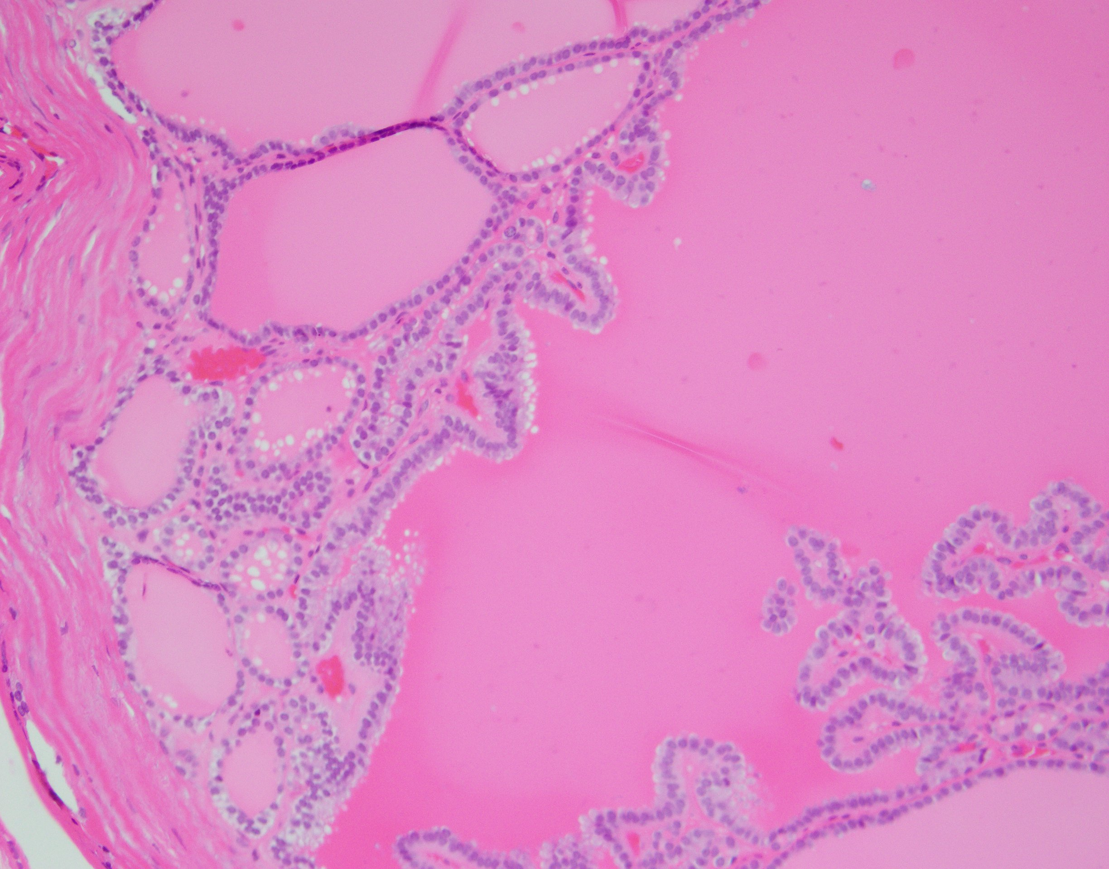
Follicular adenoma with papillary architecture

Slide 12
Follicular adenoma with papillary architecture
Few arise in the setting of thyroid follicular nodular disease (multinodular goiter)
Most occur in patients with McCune Albright syndrome, Carney complex, PTEN-HTS, and DICER1 syndrome

Slide 13
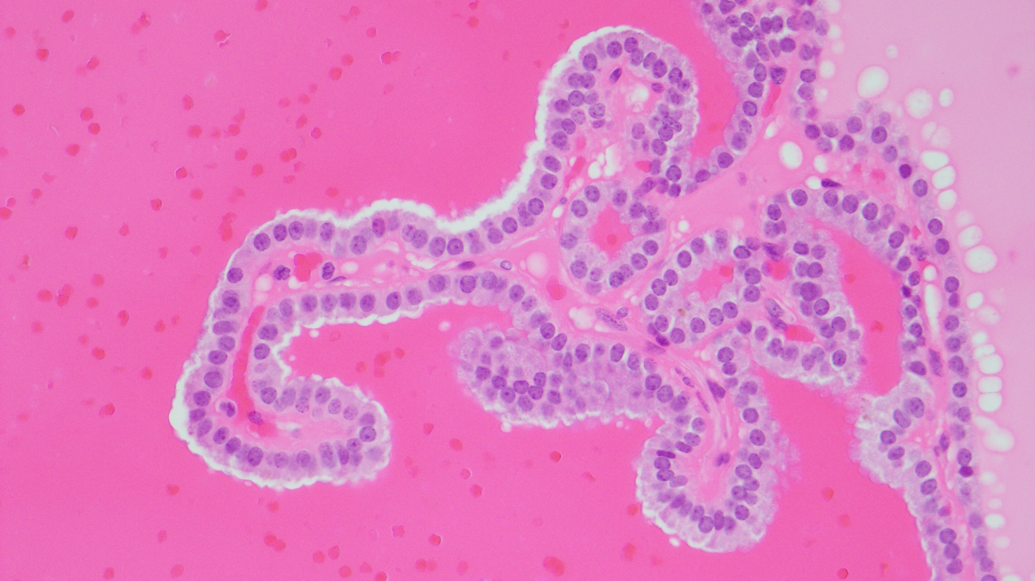
Large follicles with complex papillary infoldings of the lining epithelium, with broad papillae showing an organized centripetal orientation

Slide 14
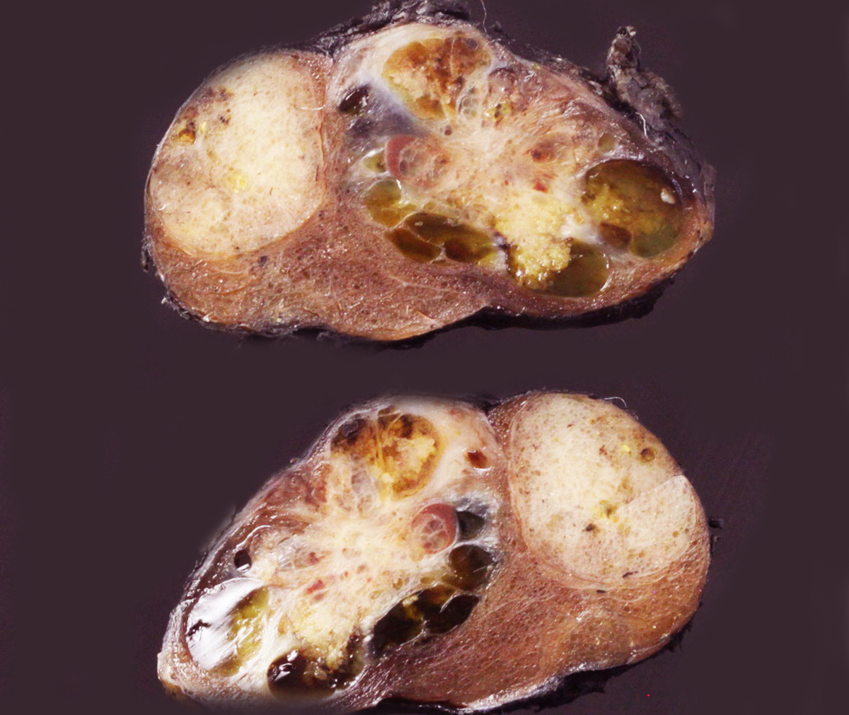
Thyroid Follicular Nodular Disease (FND)

Slide 15
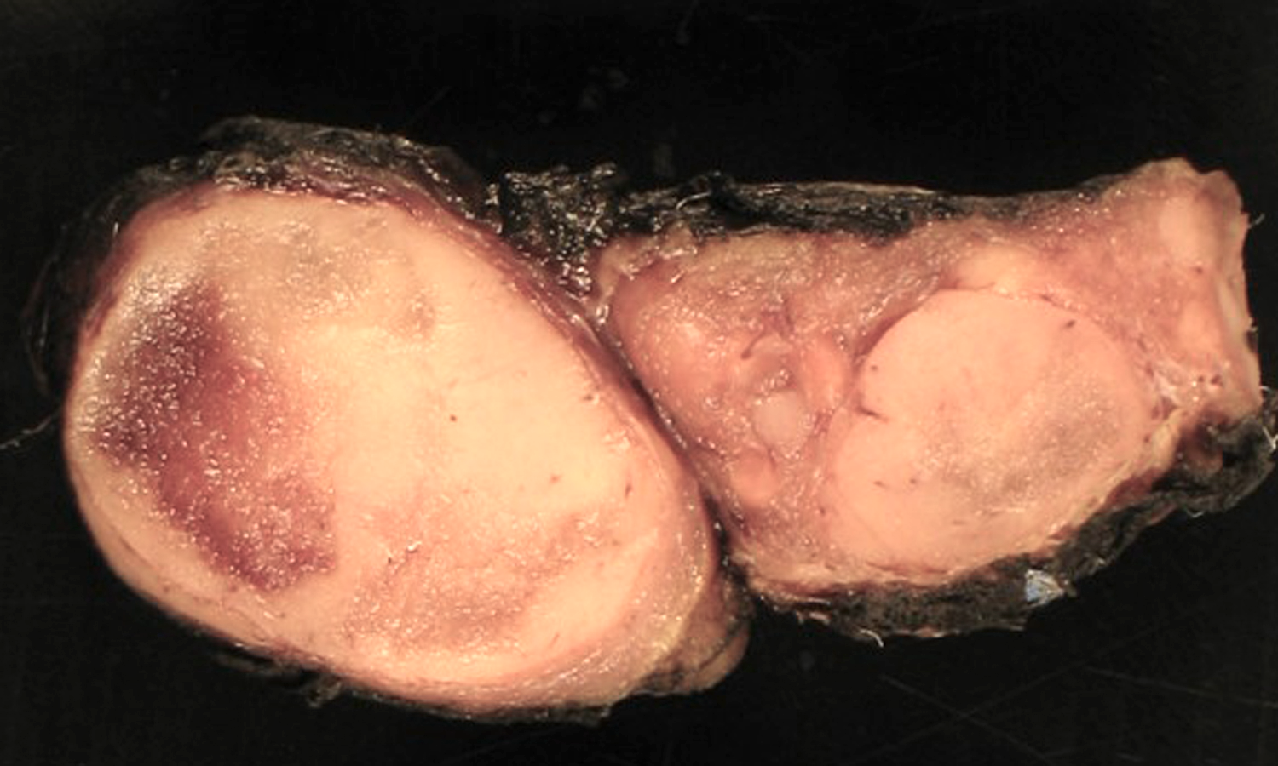

Slide 16
Thyroid Follicular Nodular Disease (FND)
Follicular nodules in MNG develop due to the proliferation of multiple cells in response to growth factors and cytokines
Clonal nodules do occur in the background of MNG and represent true neoplasms
Familial and early-onset FND can also be associated with DICER1 syndrome
TSHR and GNAS, PRKAR1A (typically in the setting of Carney complex) and EZH1 mutations

Slide 17
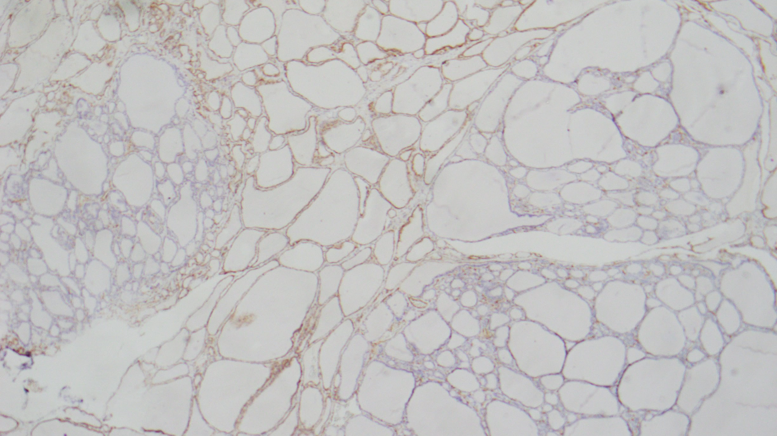
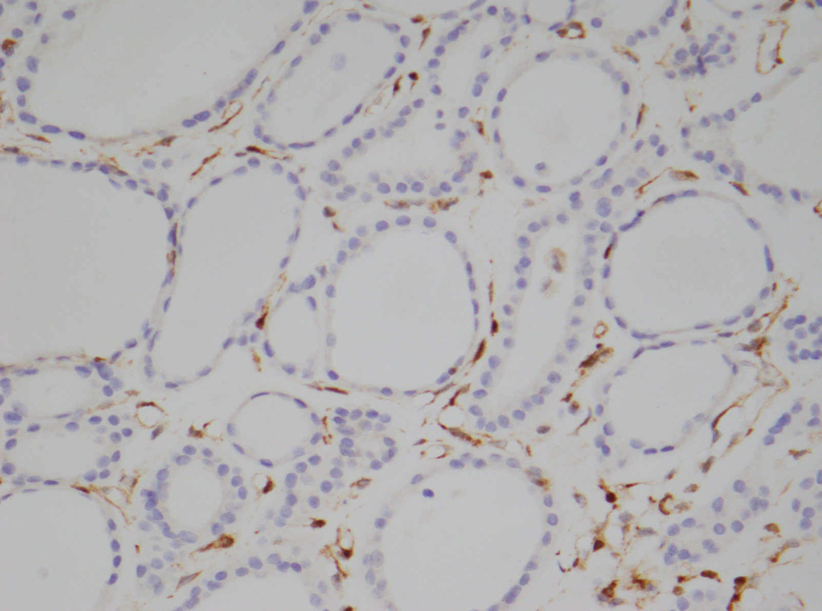
PTEN

Slide 18
5th Edition WHO Classification of Endocrine and Neuroendocrine Tumors
Low-risk follicular cell-derived:
Non-invasive follicular thyroid neoplasm with papillary-like nuclear features (NIFTP)
Thyroid tumors of uncertain malignant potential
Hyalinizing trabecular tumor

Slide 19
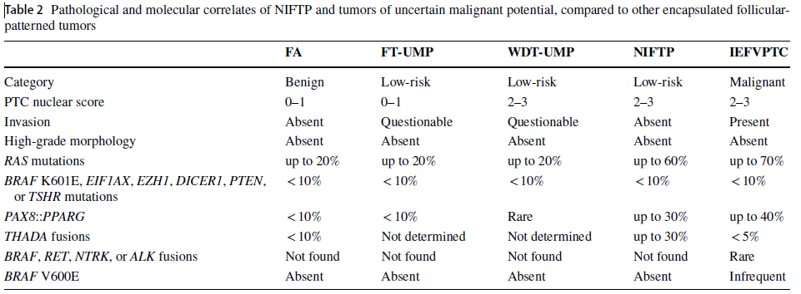

Slide 20
5th Edition WHO Classification of Endocrine and Neuroendocrine Tumors
Malignant follicular cell-derived neoplasms
Stratified based on molecular profiles and aggressiveness
Papillary thyroid carcinomas, and its morphological subtypes, represent the BRAF-like malignancies
Invasive encapsulated follicular variant PTC and follicular thyroid carcinoma represent the RAS-like malignancies

Slide 21
5th Edition WHO Classification of Endocrine and Neuroendocrine Tumors
Malignant follicular cell-derived neoplasms
The new WHO classification requires detailed subtyping of papillary microcarcinomas similar to their counterparts that exceed 1.0 cm and recommends not designating them as a subtype of PTC

Slide 22
WHO 2022: Malignant Follicular cell-derived Tumors: The Refashioned
PTC Variants Subtypes (exception FVPTC)
Follicular Variant of PTC - Separate Entity from PTC
Hurthle Cell Thyroid Carcinoma Oncocytic Thyroid Carcinoma
Squamous Cell Carcinoma of the Thyroid Morphological Pattern of Anaplastic Thyroid Carcinoma
Mucinous Thyroid Carcinoma Part of the Mucoepidermoid Carcinoma Spectrum

Slide 23
5th Edition WHO Classification of Endocrine and Neuroendocrine Tumors
Papillary thyroid carcinomas, and its morphological subtypes, represent the BRAF-like malignancies
Invasive encapsulated follicular variant PTC and follicular thyroid carcinoma represent the RAS-like malignancies

Slide 24
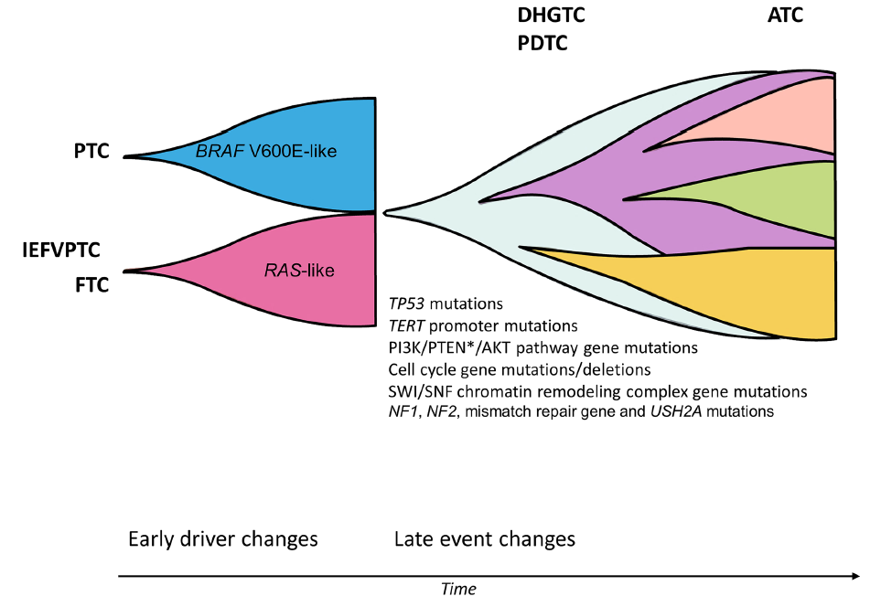
Thyroid cancer can be divided into BRAF V600E-like and RAS-like tumors based on mutational and transcriptomic profiles Additional cluster composed of non-BRAF-/non-RAS-like tumors
BRAF V600E-like alterations typically include gene fusions in ALK, BRAF, RET, NTRK1/3, and MET
RAS-like alterations include BRAF K601E, DICER1, EZH1, EIF1AX, and PTEN mutations and gene fusions in PPARG and THADA
While many PTC subtypes adhere to the BRAF-like cluster, IEFVPTC and FTC in general cluster together as both entities harbor RAS-like aberrations

Slide 25
5th Edition WHO Classification of Endocrine and Neuroendocrine Tumors
The term “Hurthle cell” is discouraged, since it is a misnomer
Oncocytic carcinoma is a distinct entity characterized by:
Oncocytic follicular cell-derived neoplasms (composed of > 75% oncocytic cells)
Lack characteristic nuclear features of PTC (those would be oncocytic PTCs)
Lack high-grade features (necrosis and ≥ 5 mitoses per 2 mm2)

Slide 26
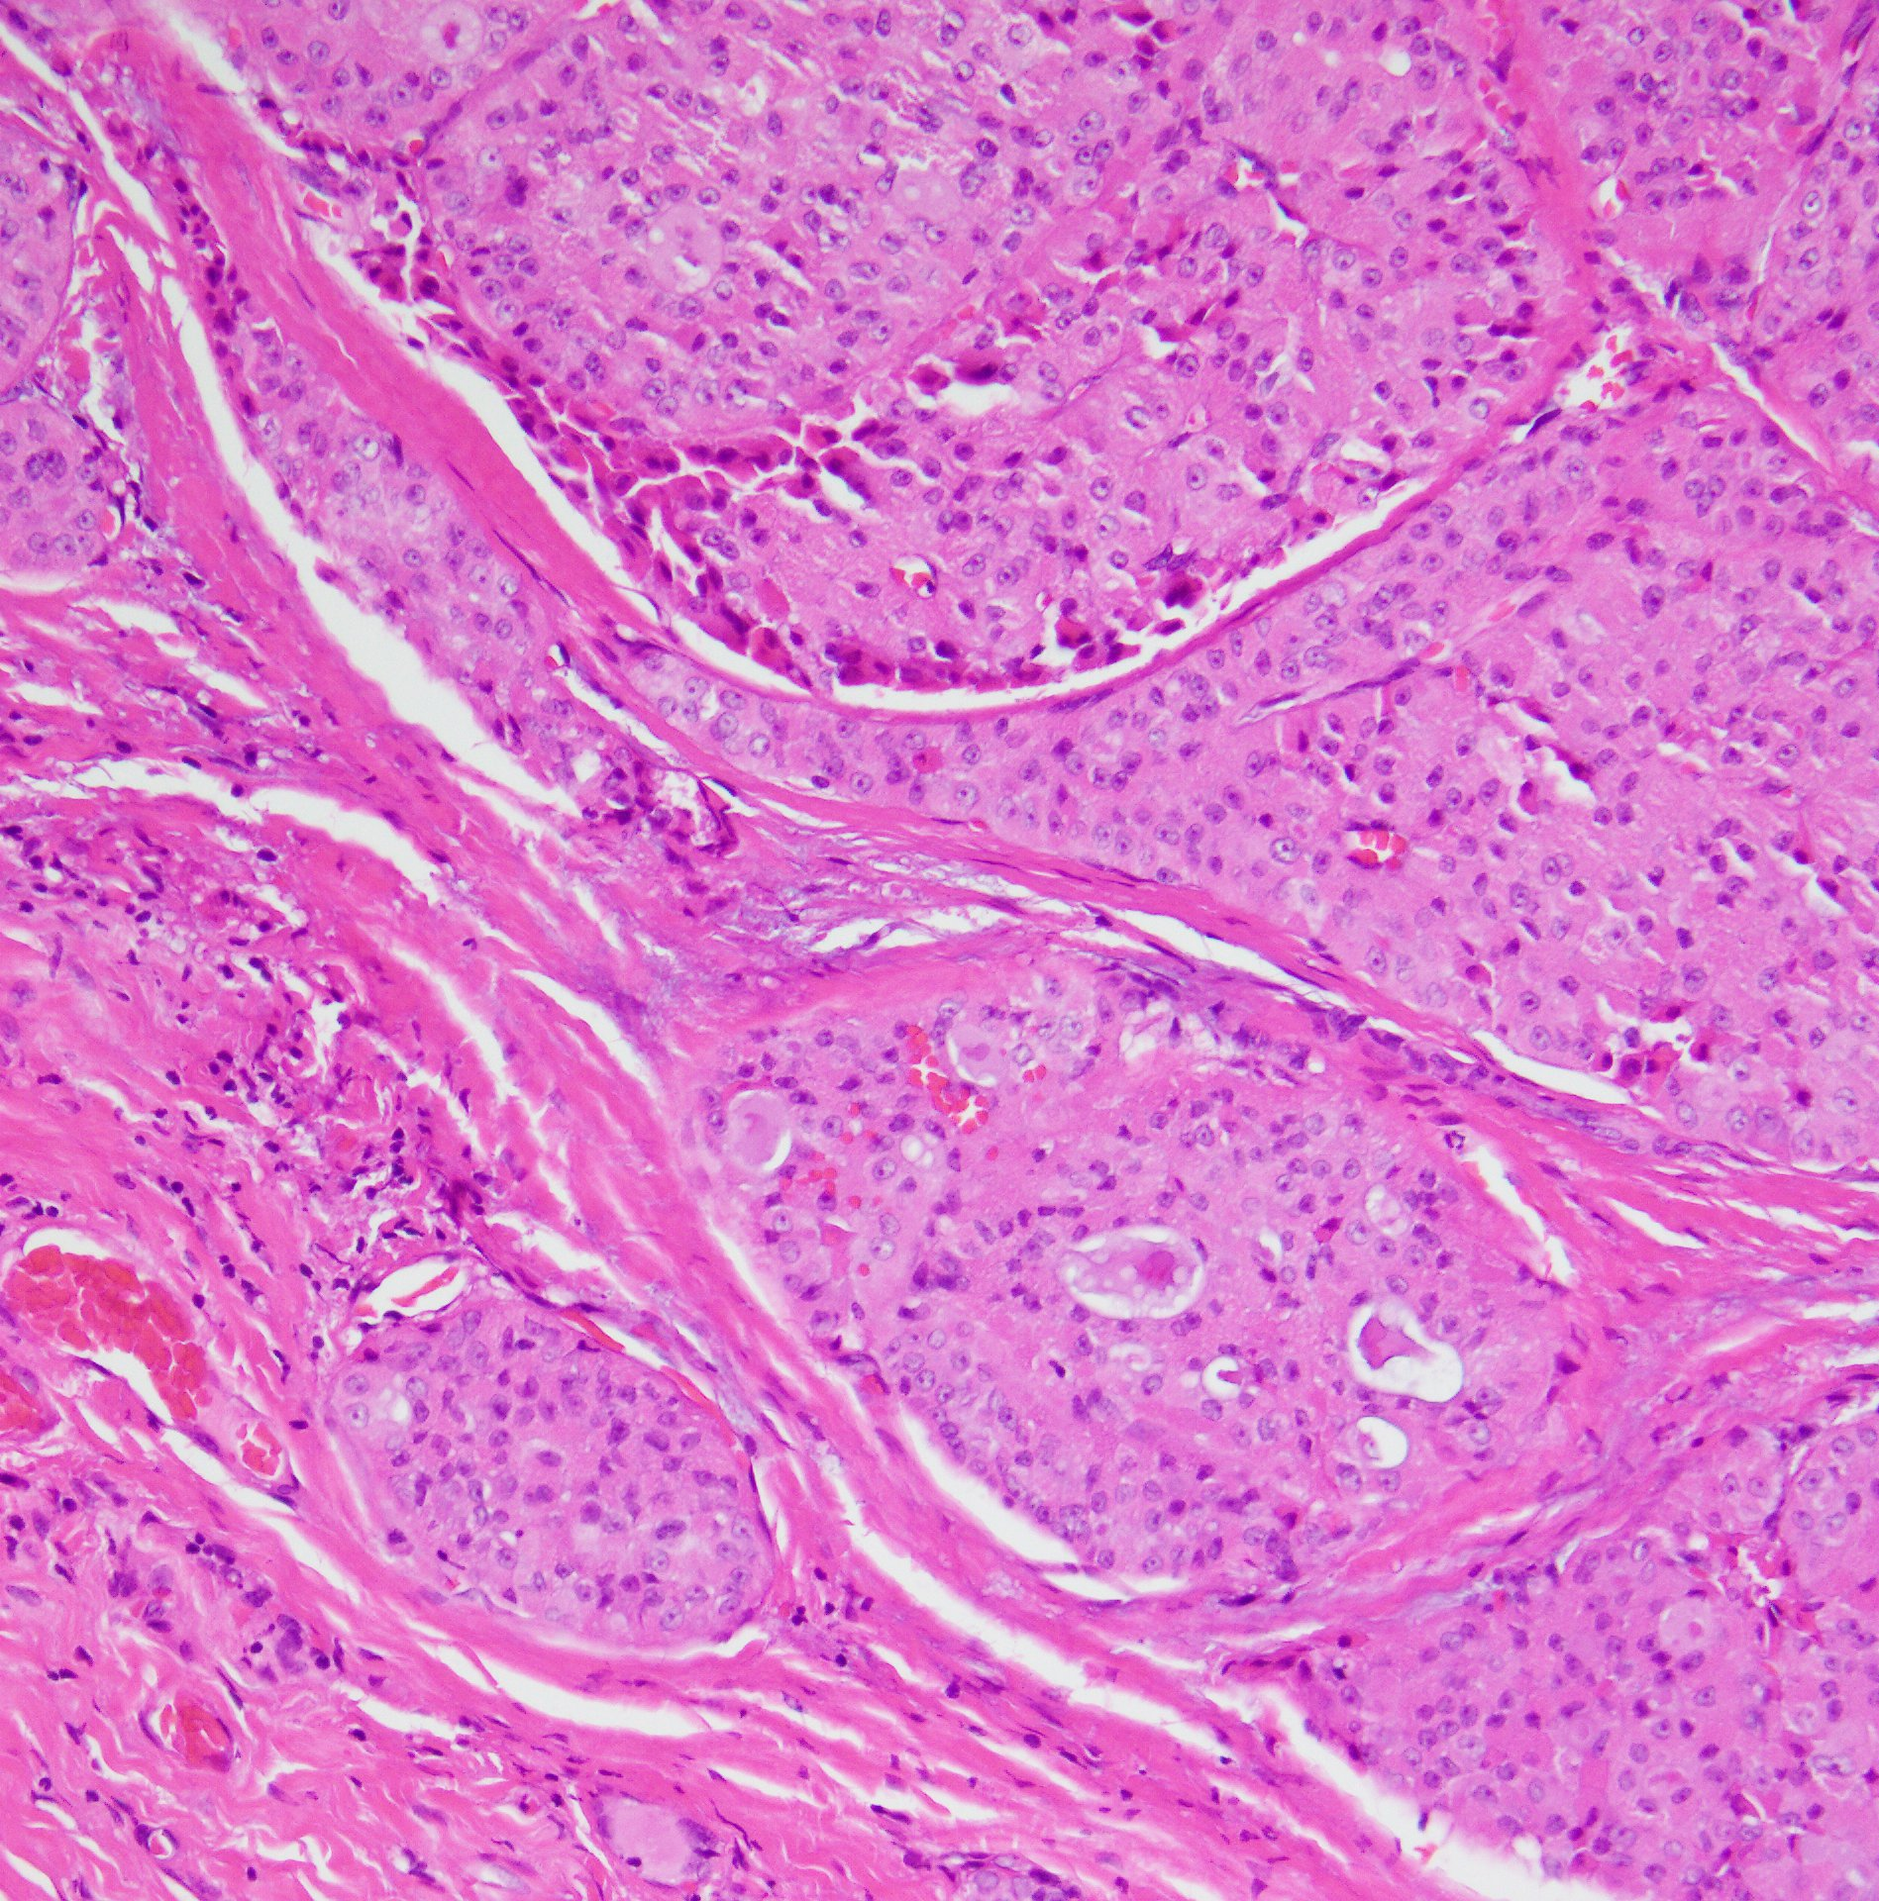
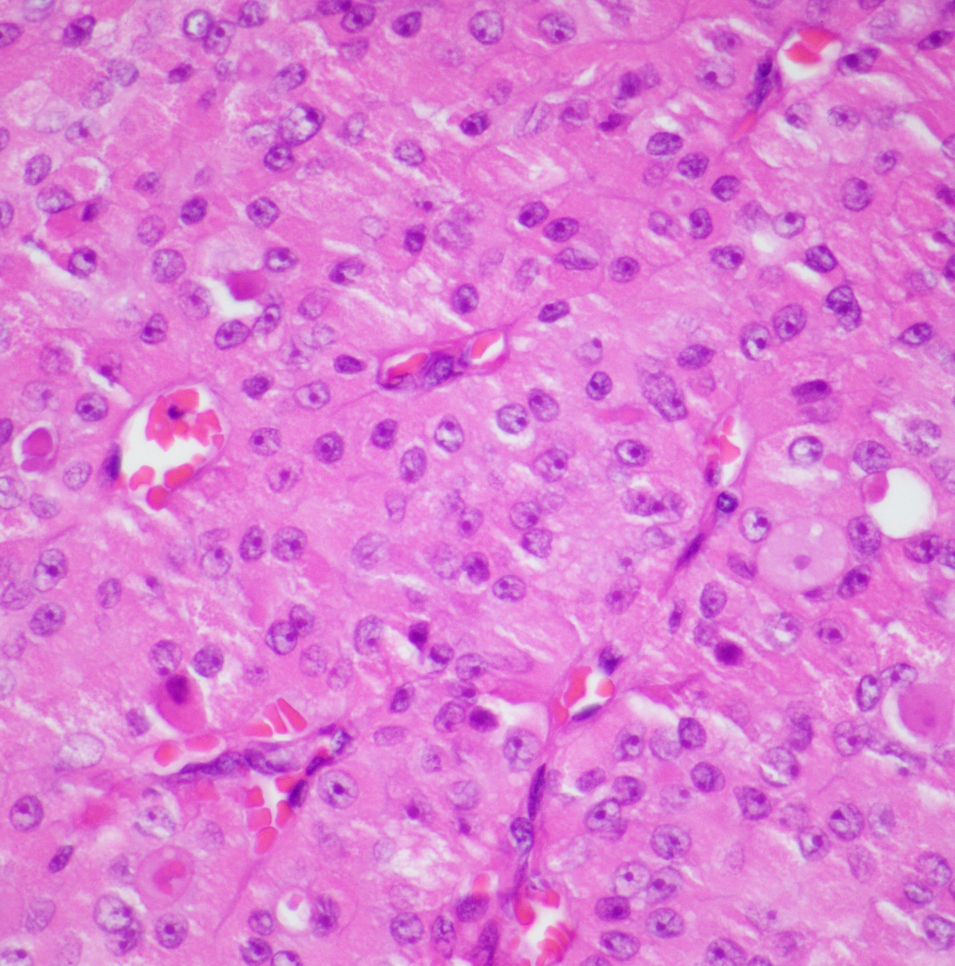
Oncocytic follicular cell-derived neoplasms
Notes:
S21 44191

Slide 27
High Grade Thyroid Tumors
High-grade follicular cell-derived malignancy:
Poorly differentiated carcinoma
High-grade differentiated thyroid carcinomas
-Both are characterized by increased mitotic activity and tumor necrosis without anaplastic histology and clinically behave in a similar manner

Slide 28
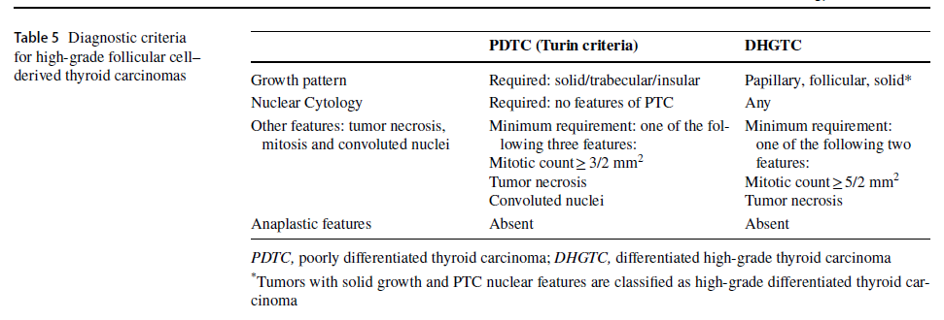

Slide 29
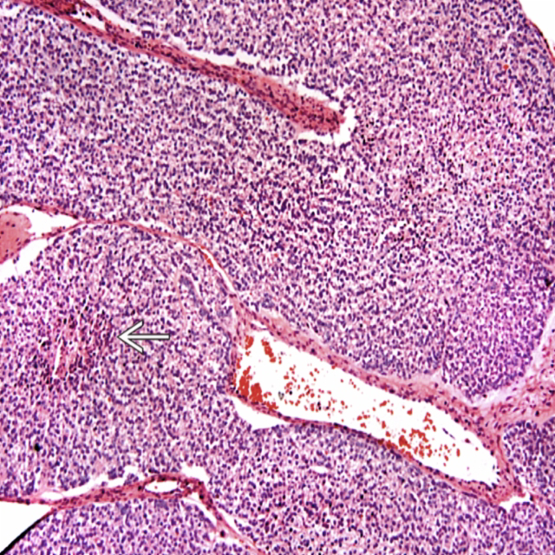

Slide 30
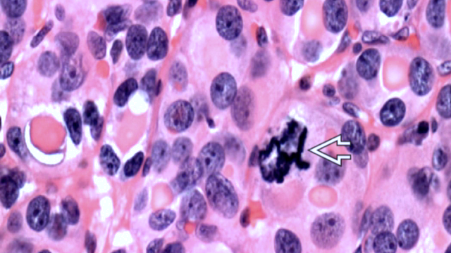

Slide 31
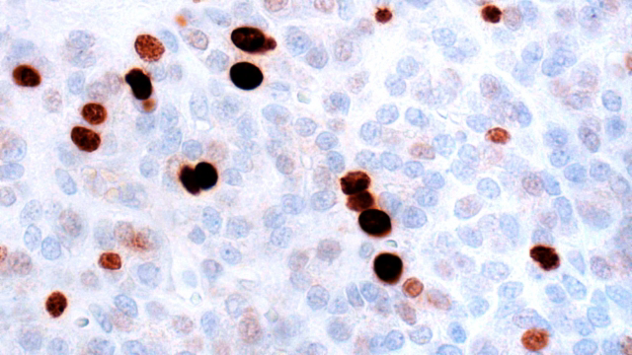

Slide 32
High-grade Differentiated Thyroid Carcinoma

Slide 33
High Grade Thyroid Tumors
High-grade follicular cell-derived malignancy:
Anaplastic thyroid carcinoma remains the most undifferentiated form
Squamous cell carcinoma of the thyroid is now considered as a subtype of anaplastic carcinoma

Slide 34
Follicular Cell-derived Carcinoma: Summary
Malignant Follicular Cell-derived Neoplasms
Follicular thyroid carcinoma
Invasive encapsulated follicular variant papillary carcinoma
Papillary thyroid carcinoma
Oncocytic carcinoma of the thyroid
Follicular-derived carcinomas, high-grade:
Differentiated thyroid carcinoma, high grade
Poorly differentiated thyroid carcinoma
Anaplastic follicular cell-derived thyroid carcinoma

Slide 35
Thyroid Carcinoma Classification: Summary
3. Thyroid C-cell derived carcinoma
Medullary thyroid carcinoma
4. Mixed medullary and follicular-cell derived carcinomas
Mixed medullary and follicular cell-derived thyroid carcinoma

Slide 36
5th Edition WHO Classification of Endocrine and Neuroendocrine Tumors
Medullary thyroid carcinomas derived from thyroid C cells retain their distinct section
Separate section for mixed tumors composed of both C cells and any follicular cell-derived malignancy
A grading system for medullary thyroid carcinomas is also introduced based on mitotic count, tumor necrosis, and Ki67 labeling index

Slide 37
Medullary Thyroid Carcinoma and Grading
GRADING
Two-tiered consensus grading scheme:
High-grade MTC contains at least one of the following:
Mitotic count >5 per 2 mm²
Ki-67 proliferation index >5%
Tumor necrosis
High-grade has been correlated with poorer prognosis:
Overall survival
Disease-specific survival
Local recurrence free survival
Distant metastasis free survival

Slide 38
Mitotic count per 2mm² | Ki67 proliferative index | Tumor necrosis | Grade
<5 | <5% | Absent | Low
≥5 and/or ≥5% and/or Present |  |  | High

Slide 39
Approximately 25% of patients with MTC will have MEN2 and germline testing for RET mutations is recommended for all patients regardless of family history
Take Home Message

Slide 40
5th Edition WHO Classification of Endocrine and Neuroendocrine Tumors
A number of unusual neoplasms that occur in the thyroid have been placed into new sections based on their cytogenesis

Slide 41
WHO 2022: The Refashioned and New Diagnostic Categories
Papillary Thyroid Carcinoma, Cribriform-morular Variant Cribriform-morular Thyroid Carcinoma
Secretory Carcinoma (as part of the salivary gland-type neoplasm)
Malignant Thyroid Teratoma and Carcinosarcoma Thyroblastoma

Slide 42
2022 WHO Endocrine And Neuroendocrine Tumors: Thyroid
5. Salivary gland-type carcinomas of the thyroid
Mucoepidermoid carcinoma of the thyroid
Secretory carcinoma of salivary gland type
6. Thyroid tumors of uncertain histogenesis
Sclerosing mucoepidermoid carcinoma with eosinophilia
Cribriform morular thyroid carcinoma

Slide 43
5th Edition WHO Classification of Endocrine and Neuroendocrine Tumors
Cribriform-morular thyroid carcinoma is no longer classified as a subtype of PTC
Boyraz B, Sadow PM, Asa SL, Dias-Santagata D, Nosé V, Mete O.
Cribriform-Morular Thyroid Carcinoma Is a Distinct Thyroid Malignancy of Uncertain Cytogenesis. Endocr Pathol. 2021 Sep;32(3):327-335.

Slide 44
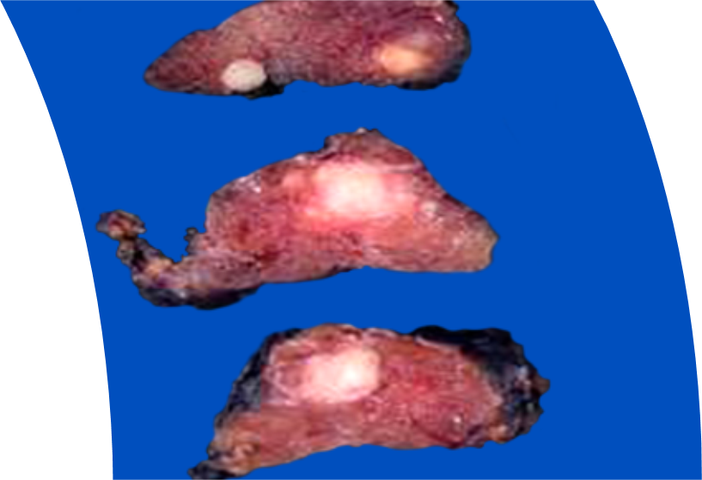
5th Edition WHO Classification of Endocrine and Neuroendocrine Tumors
Cribriform-morular thyroid carcinoma is no longer classified as a subtype of PTC
Why?

Slide 45
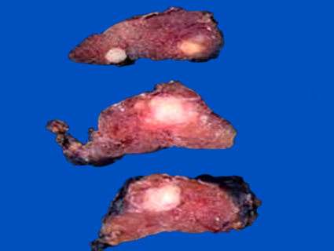
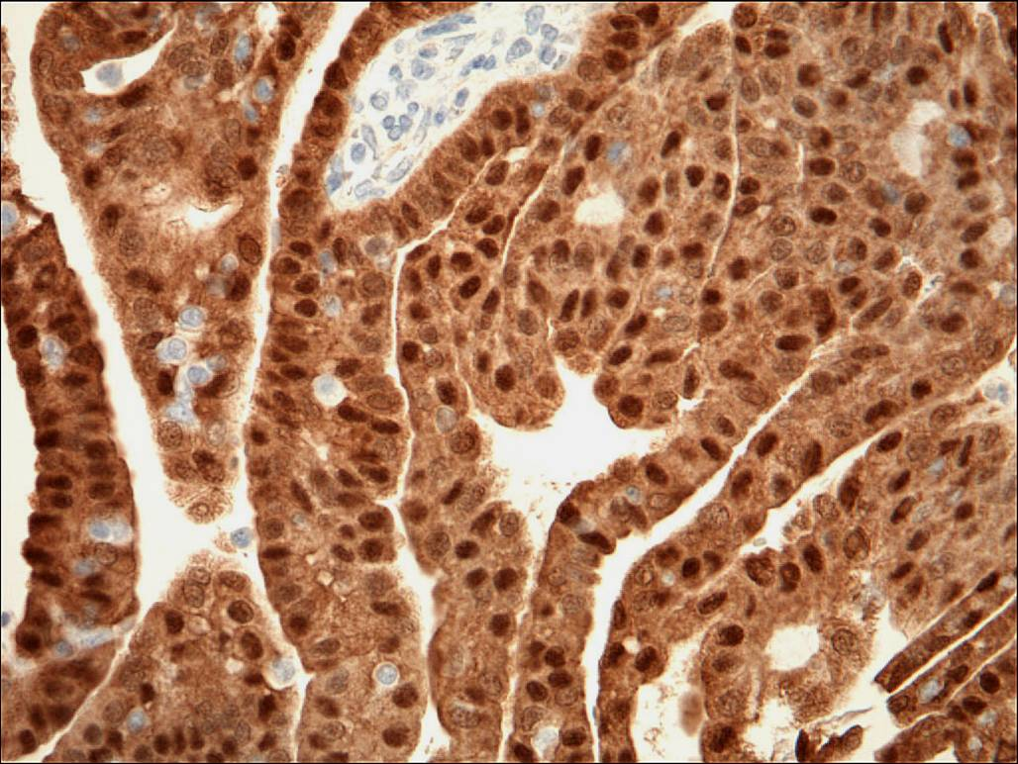
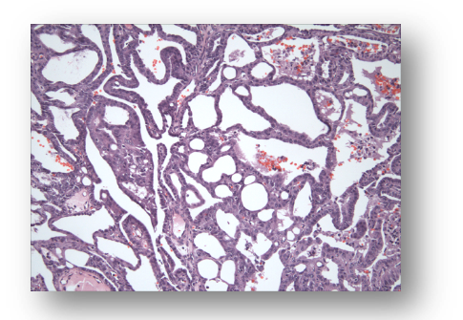
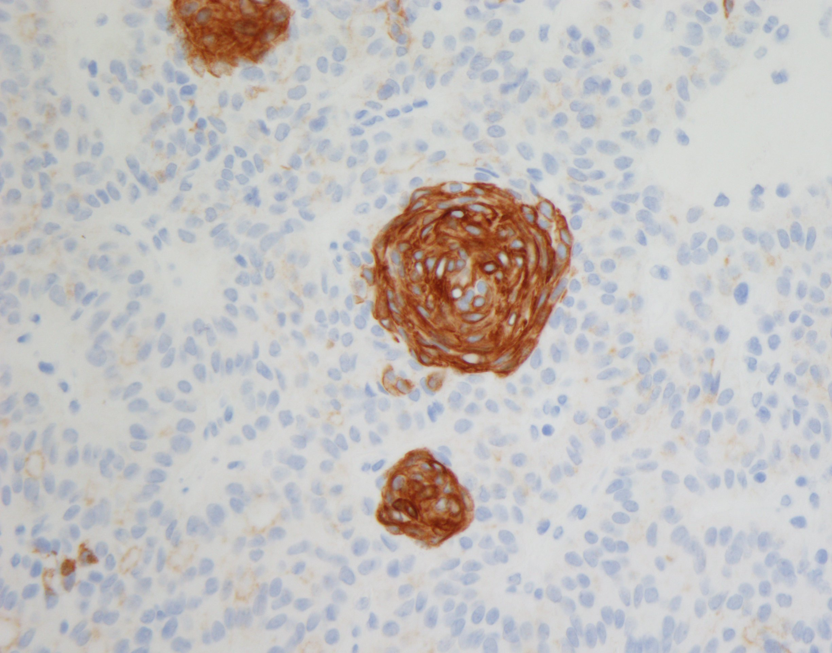
Cribriform-Morular
Thyroid Carcinoma
FAP-associated thyroid carcinoma: a distinct type of follicular cell neoplasms
First described in 1994
Harach, Williams and Williams
Papillary Thyroid Carcinoma, Cribriform Morular Variant
WHO 2017
Cribriform Morular Thyroid Carcinoma
WHO 2022

Slide 46
Familial Tumor Syndromes Characterized by a Preponderance of Non-thyroidal Tumors: Familial Adenomatous Polyposis (FAP) Syndrome
Autosomal dominant syndrome caused by germline mutations in the adenomatous polyposis coli (APC) gene on Chromosome 5q21
APC gene:
Tumor suppressor gene that down regulates B-catenin
5q21-22
Specific APC mutations correlate with Phenotype
Hotspot for severe polyposis phenotype: 1309

Slide 47
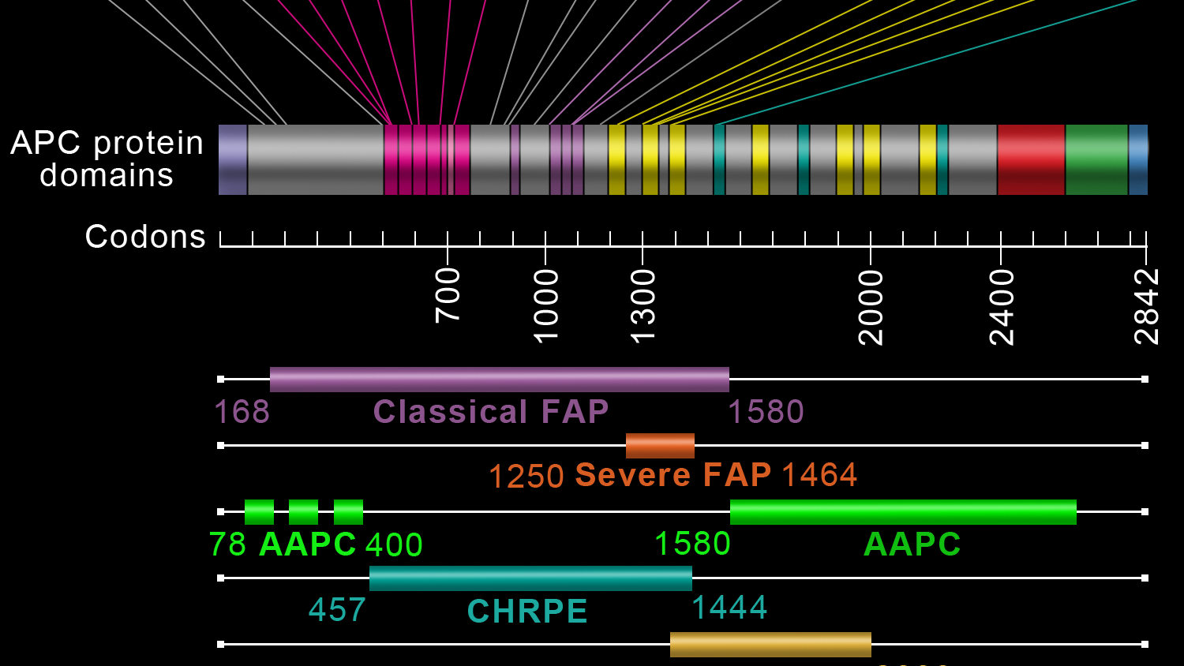

Slide 48
Familial Adenomatous Polyposis (FAP) Syndrome
Multiple colonic polyps
Extracolonic manifestations:
Osteomas
Epidermal cysts
Desmoid tumors
Congenital hypertrophy of retinal pigmented epithelium
Hepatoblastomas
Thyroid tumors

Slide 49
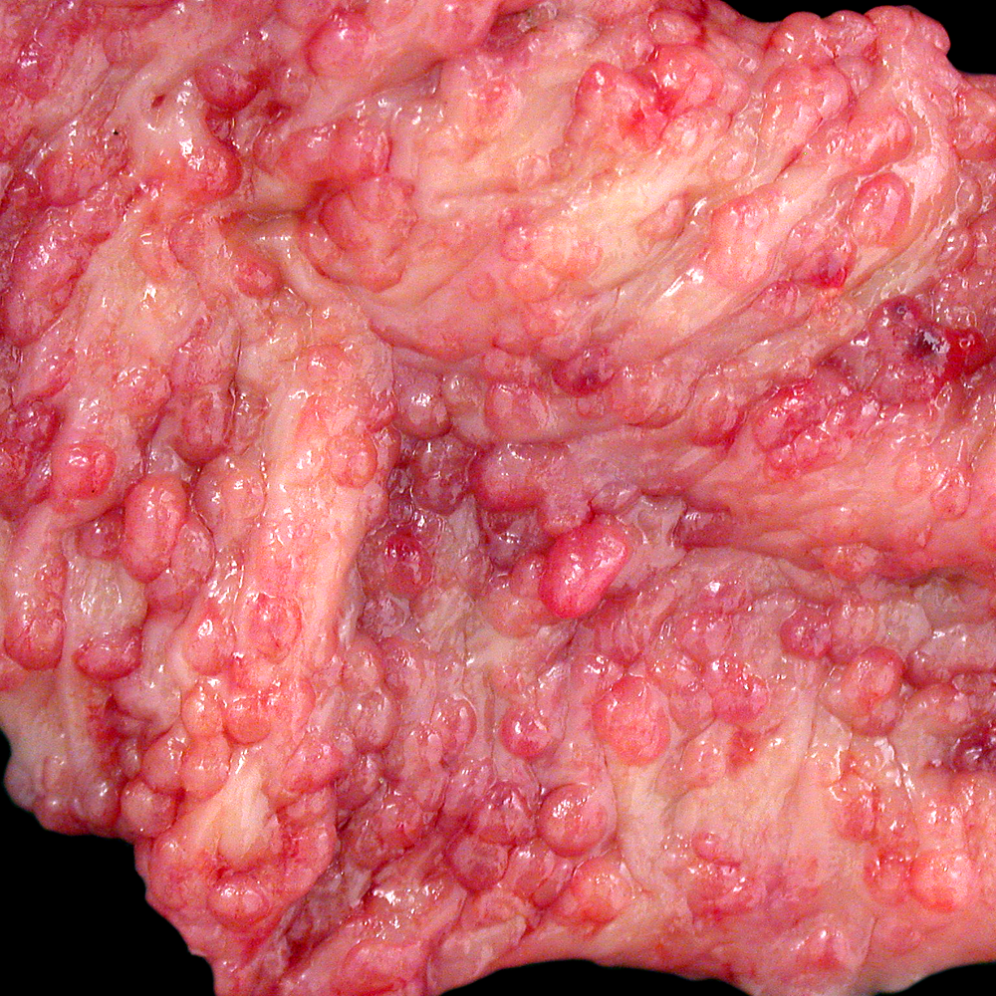
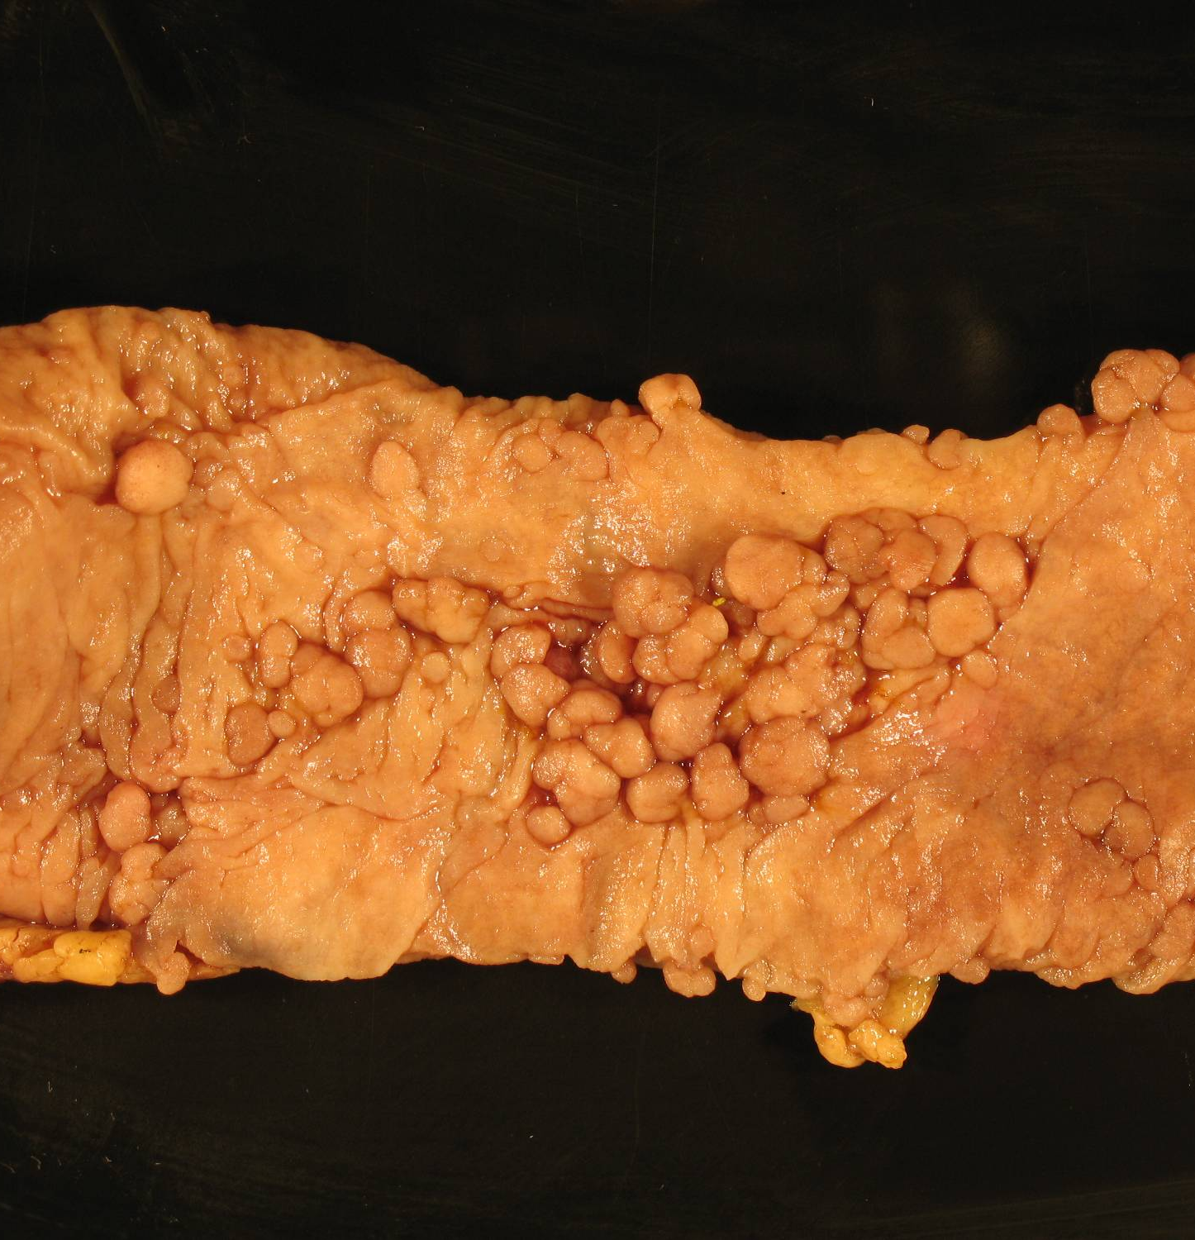

Slide 50
FAP-associated Thyroid Tumors

Slide 51
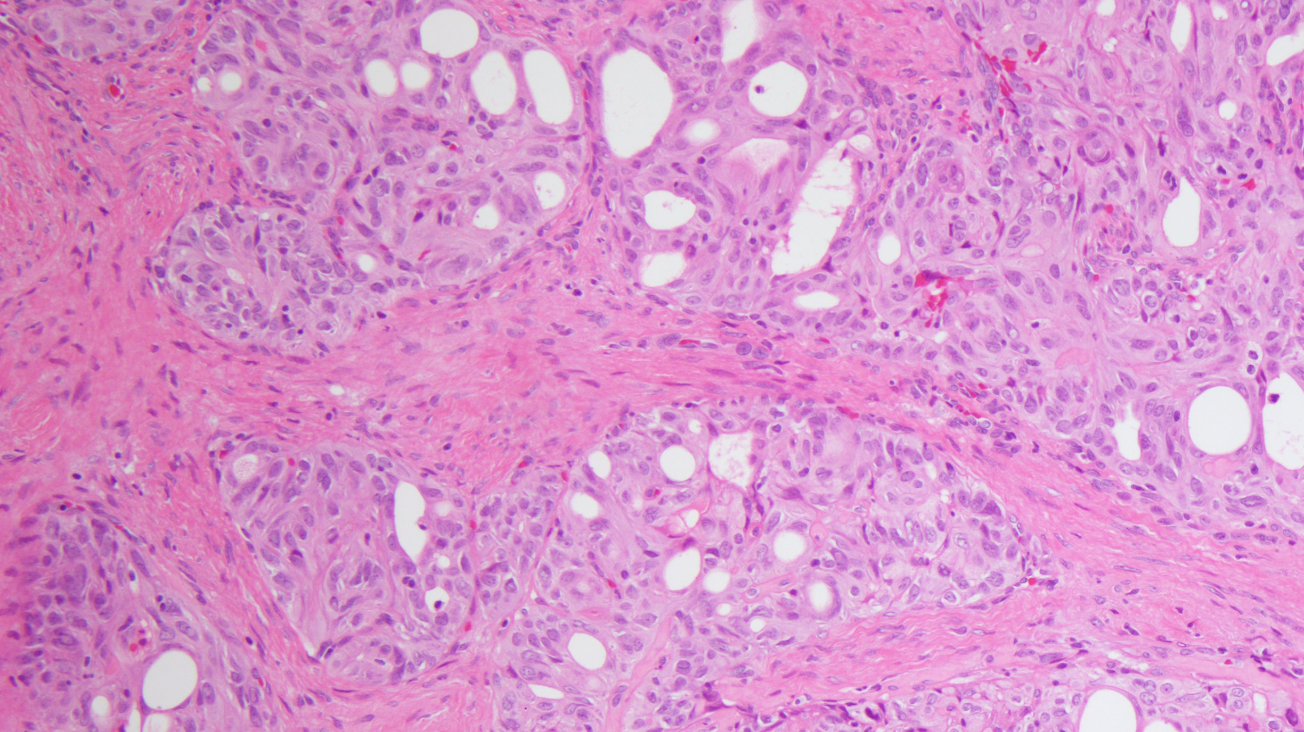

Slide 52
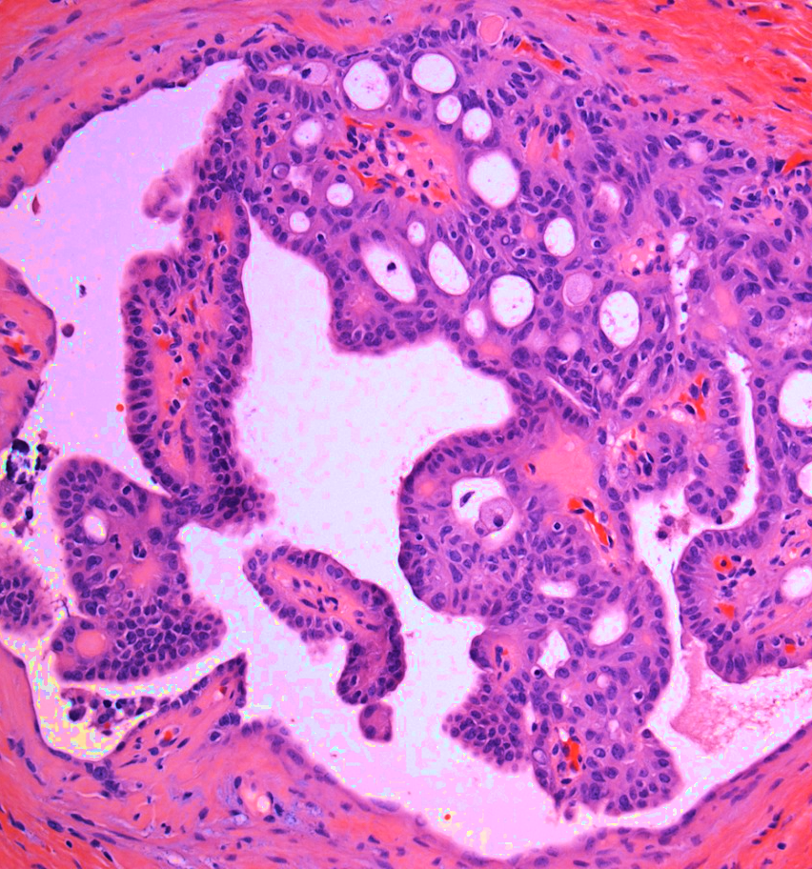
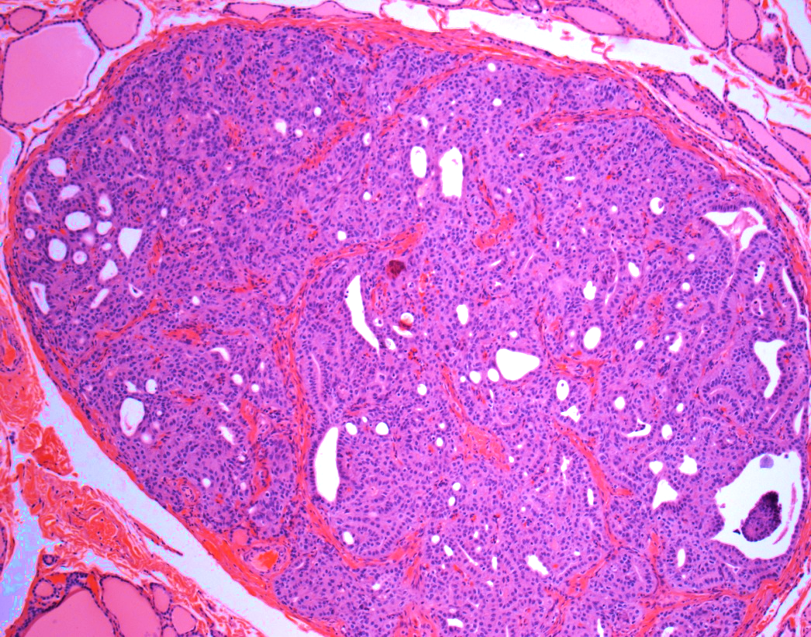

Slide 53
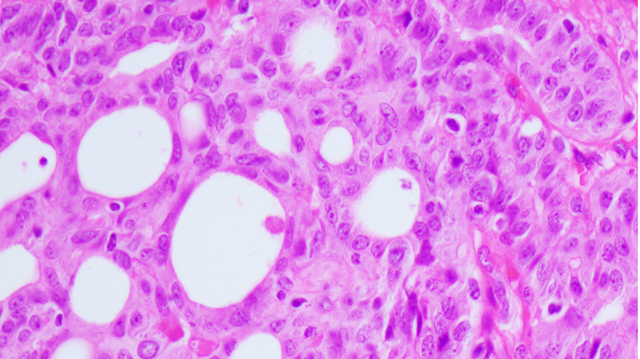
Cribriform component
Lack of colloid

Slide 54
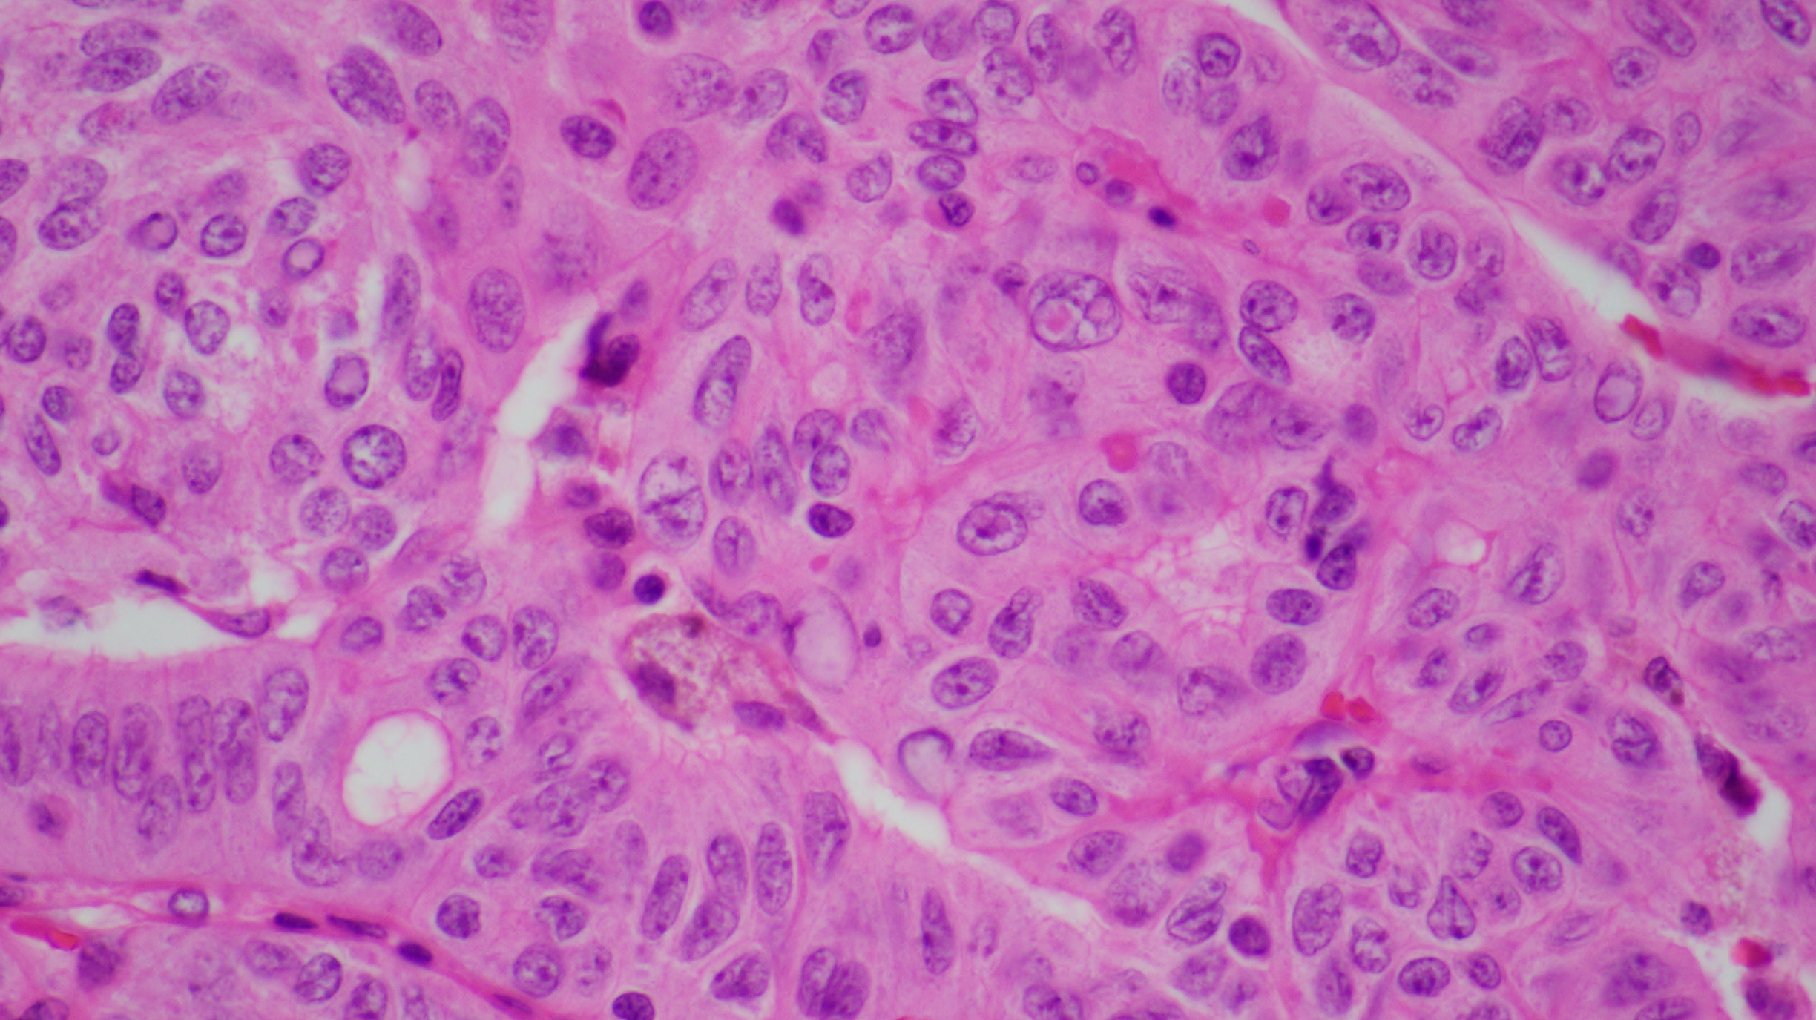
Cribriform-morular Thyroid Carcinoma

Slide 55
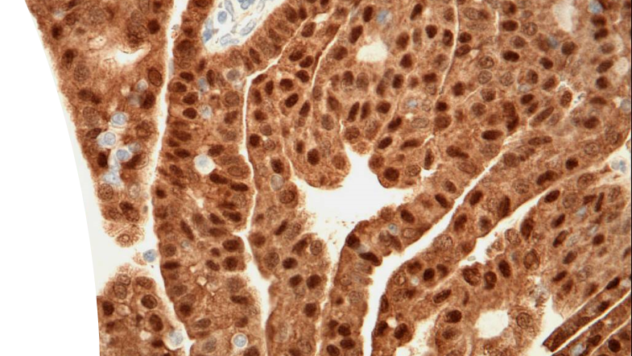
Beta-catenin

Slide 56
Cribriform-morular Thyroid Carcinoma
Morule
Peculiar nuclear clearing

Slide 57
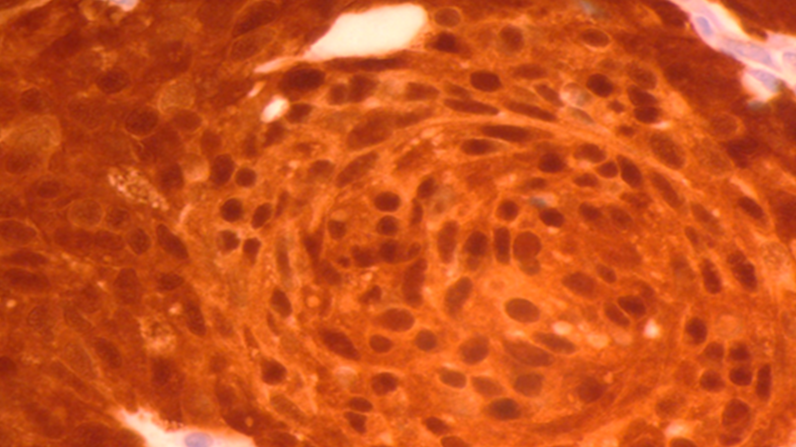
Beta-catenin

Slide 58
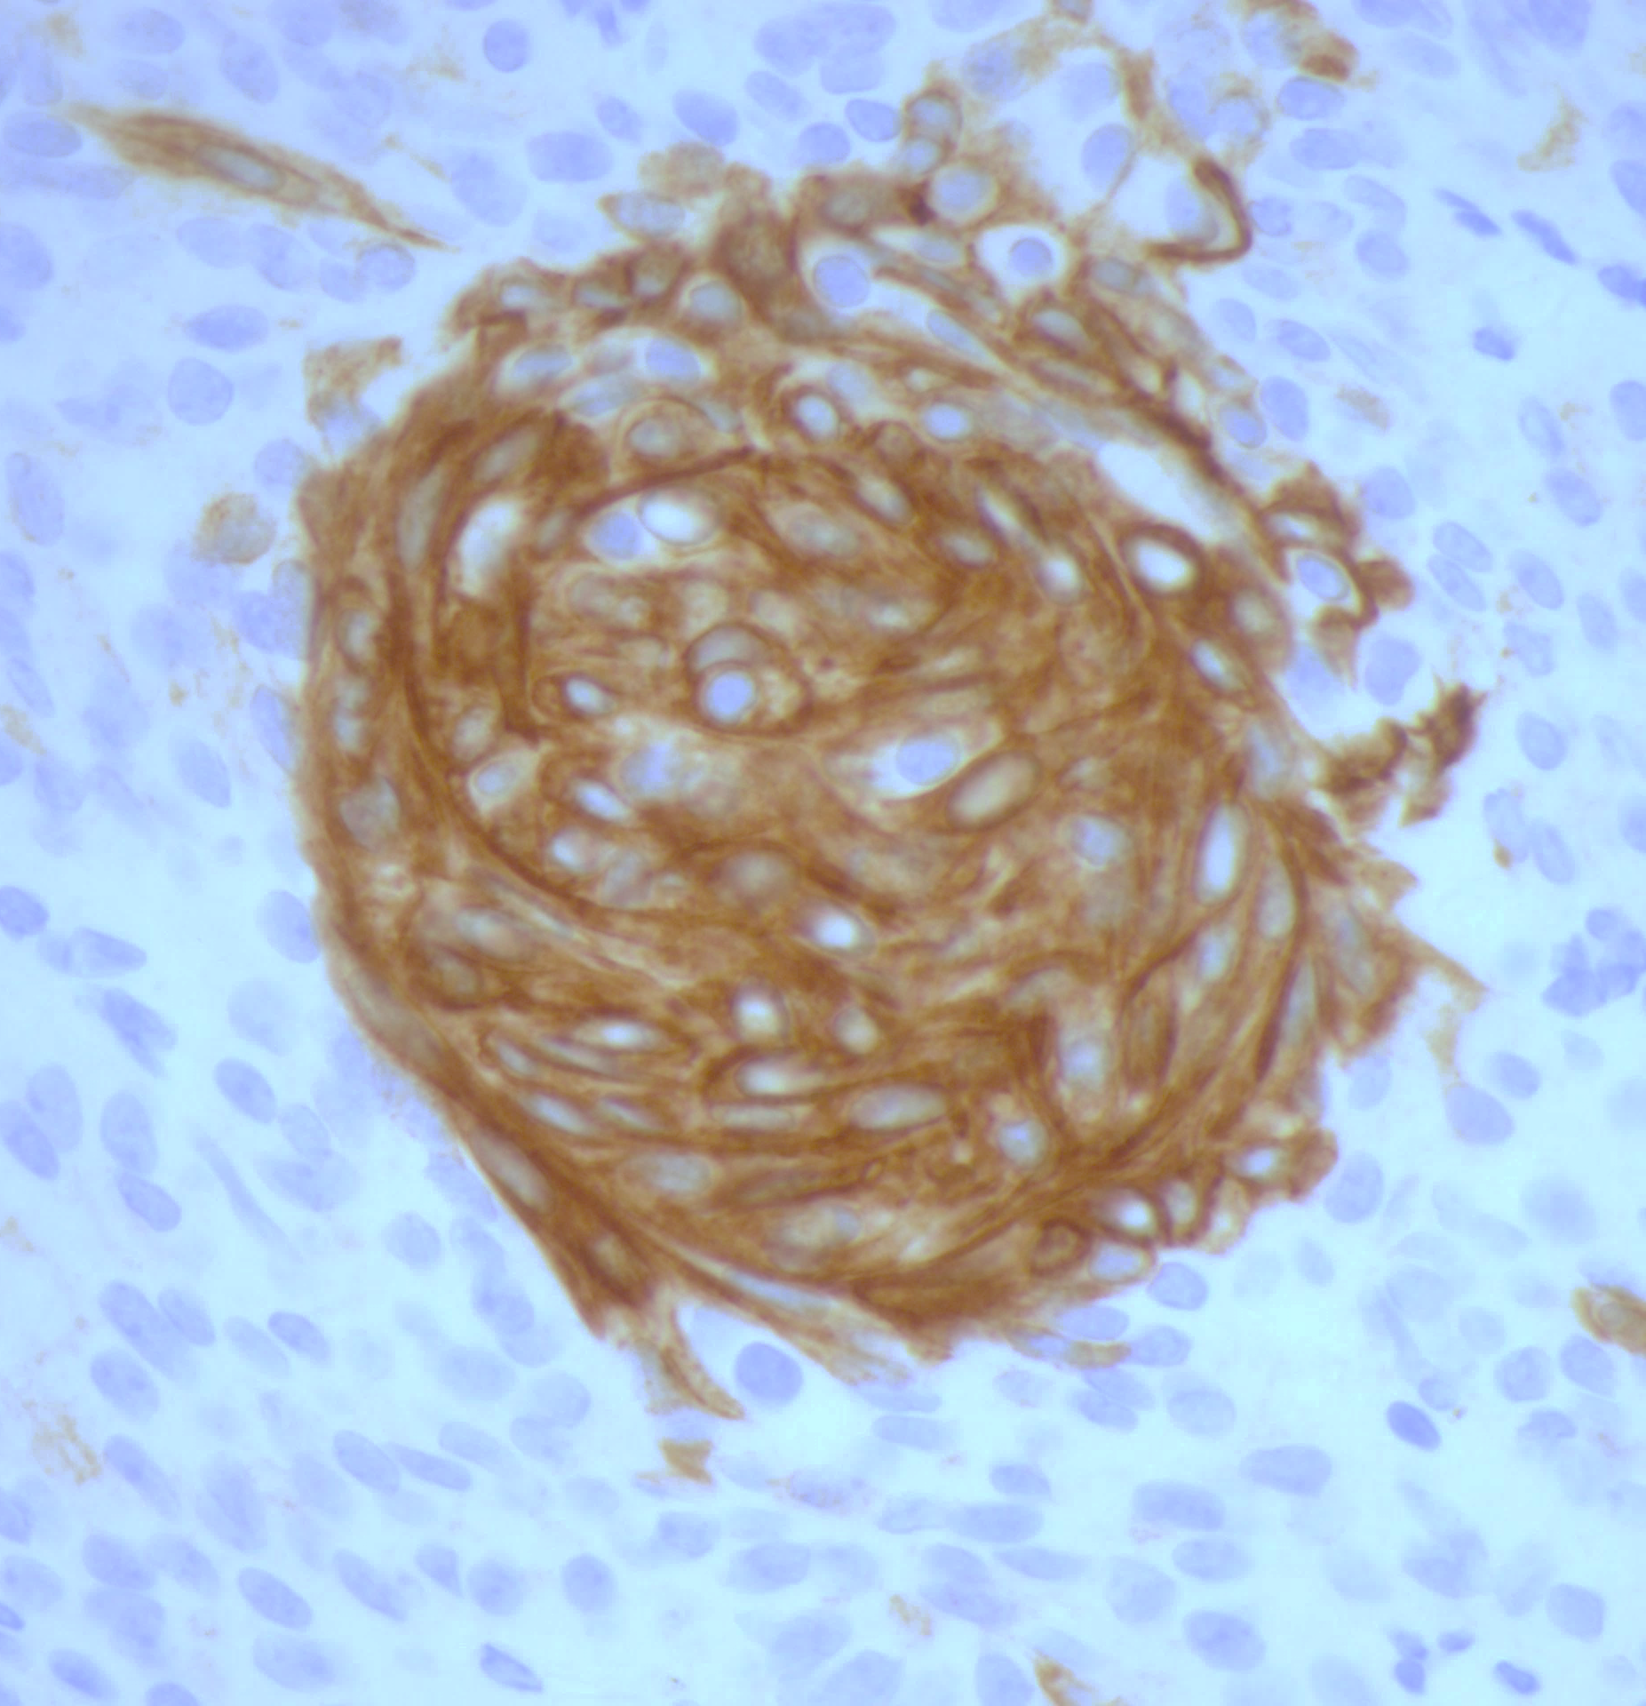
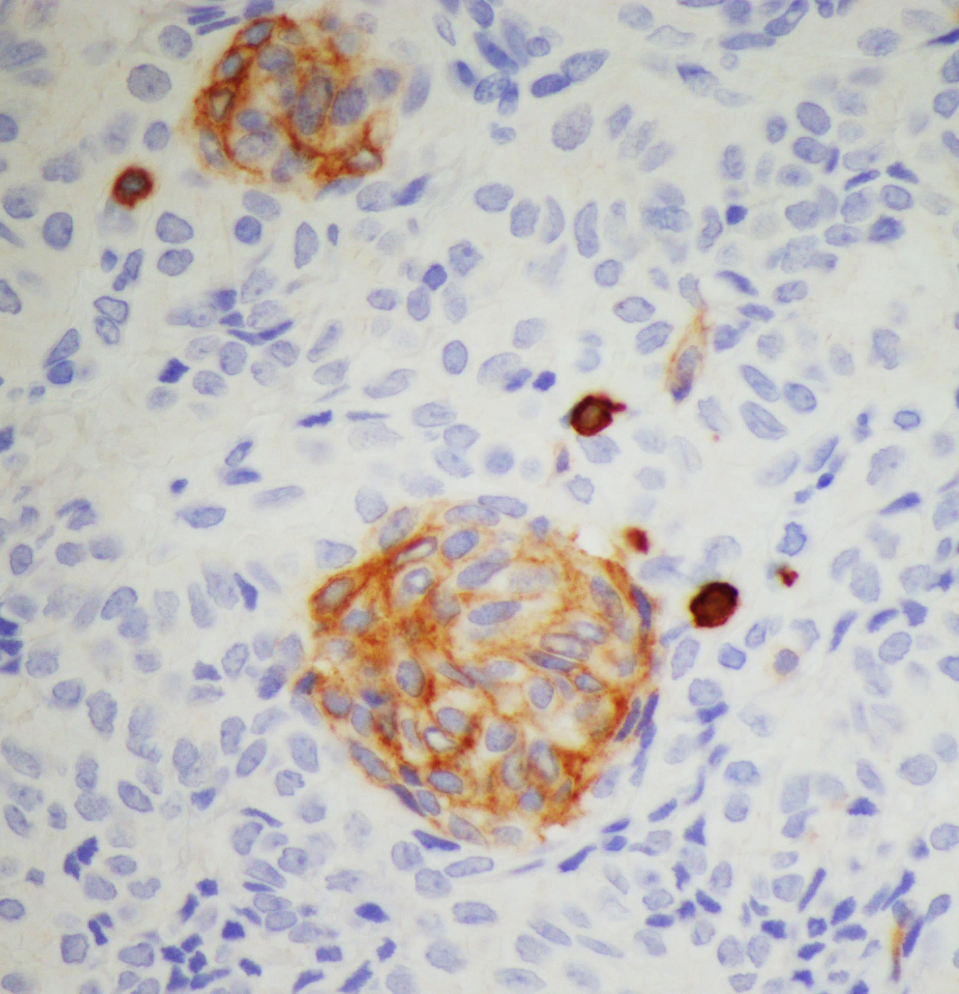
CD5
Keratin 5/6

Slide 59
Cribriform-Morular Thyroid Carcinoma
Rare tumor, ~0.2 %
In patients with FAP: 12 – 20 %
FAP patients 160 times higher risk of developing thyroid carcinoma
10 times more frequent than that expected for sporadic tumors
Striking female predominance (17:1)
Mean age of thyroid tumor diagnosis 28 years
Rare sporadic cases

Slide 60
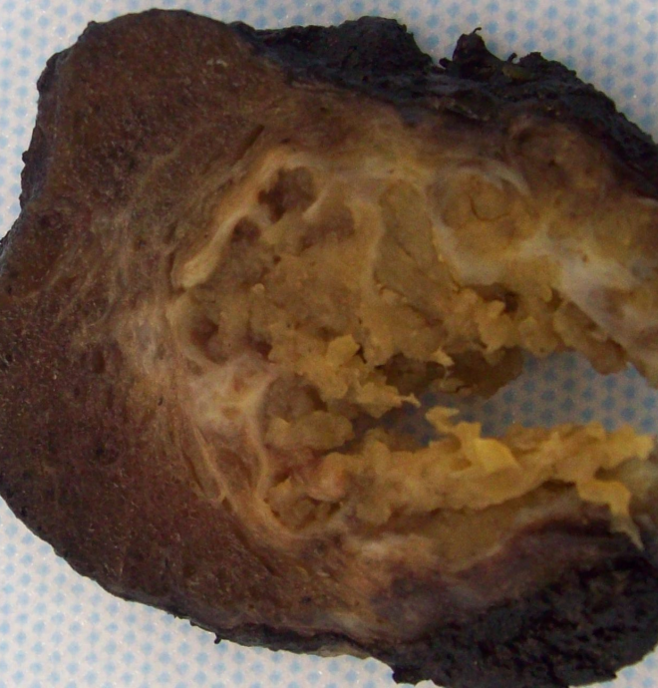
Useful Pathological Criteria: CMvPTC
Sporadic CMV-PTC
Rare
Unifocal
Larger tumor than familial
Positive stain for beta-catenin
Sporadic case of CMV-PTC have somatic but not germline mutation in APC gene

Slide 61
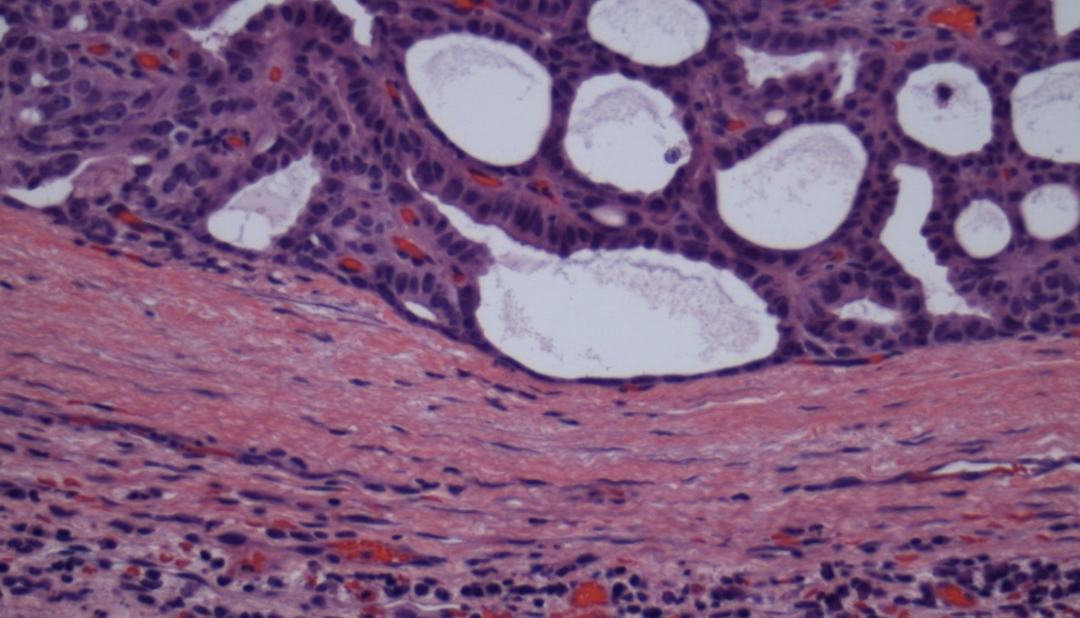
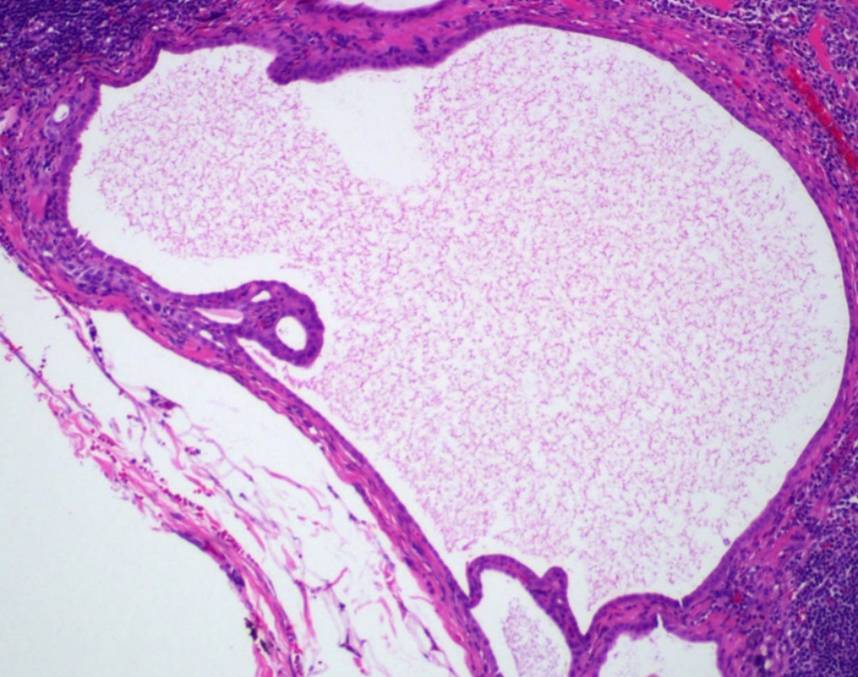
Cribriform Morular Variant of Papillary Thyroid Carcinoma: Prognosis
Familial:
-Multiple, bilateral
-Excellent prognosis

Slide 62
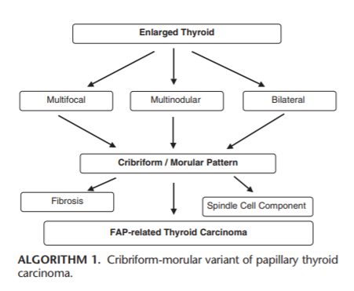
FAP-associated Thyroid Tumors: Pathologists’ Role

Slide 63
2022 WHO Endocrine And Neuroendocrine Tumors: Thyroid
7. Thymic tumors within the thyroid
Thymoma family
Spindle epithelial tumour with thymus-like elements
Thymic carcinoma family
8. Embryonal thyroid neoplasms
Thyroblastoma

Slide 64
Embryonal Thyroid Neoplasms
Thyroblastoma

Slide 65
Thyroblastoma
Thyroblastoma is an embryonal high-grade thyroid neoplasm composed of primitive thyroid-like follicular cells surrounded by a primitive small cell component and mesenchymal stroma with variable differentiation (WHO 2022)

Slide 66
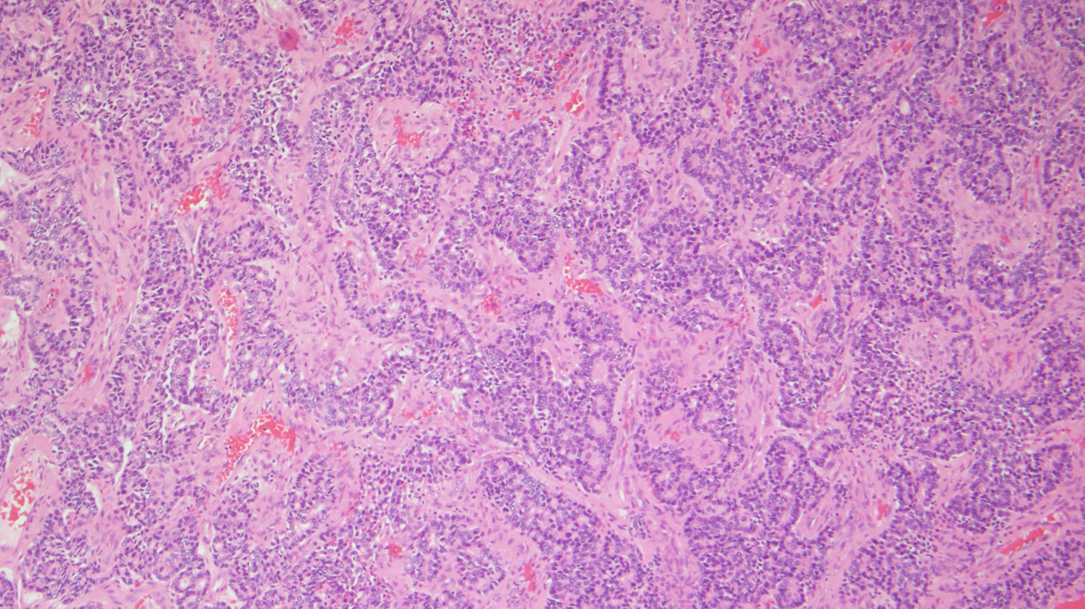
Fetal-type primitive-appearing thyroid follicles and fetal-type glands
Primitive spindle cell stroma

Slide 67
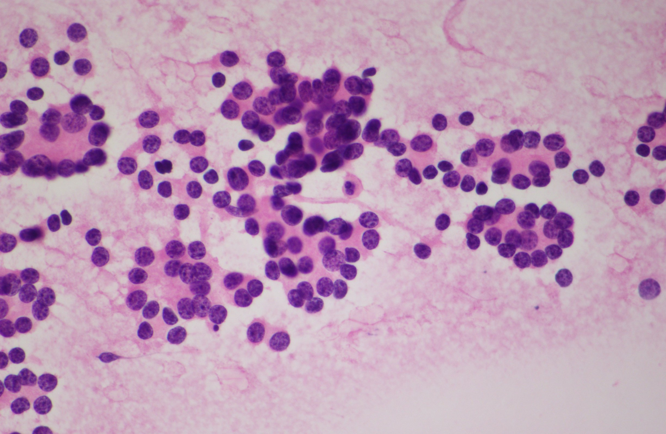
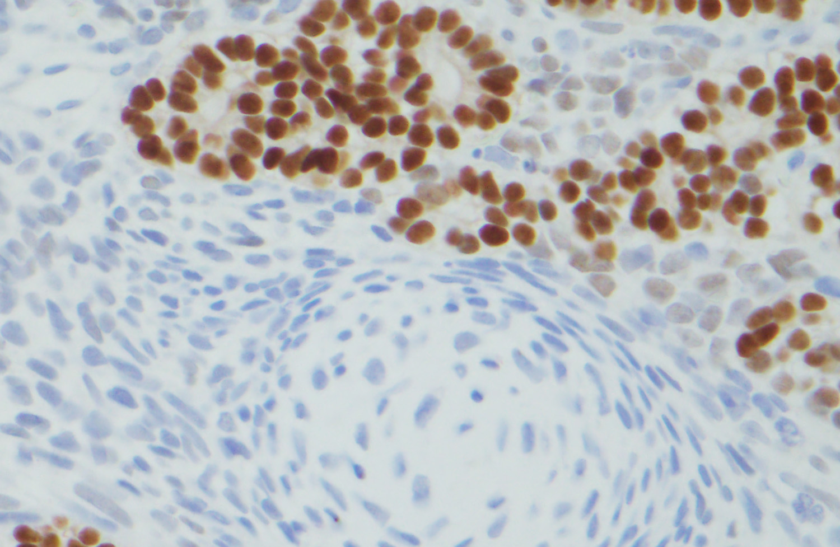
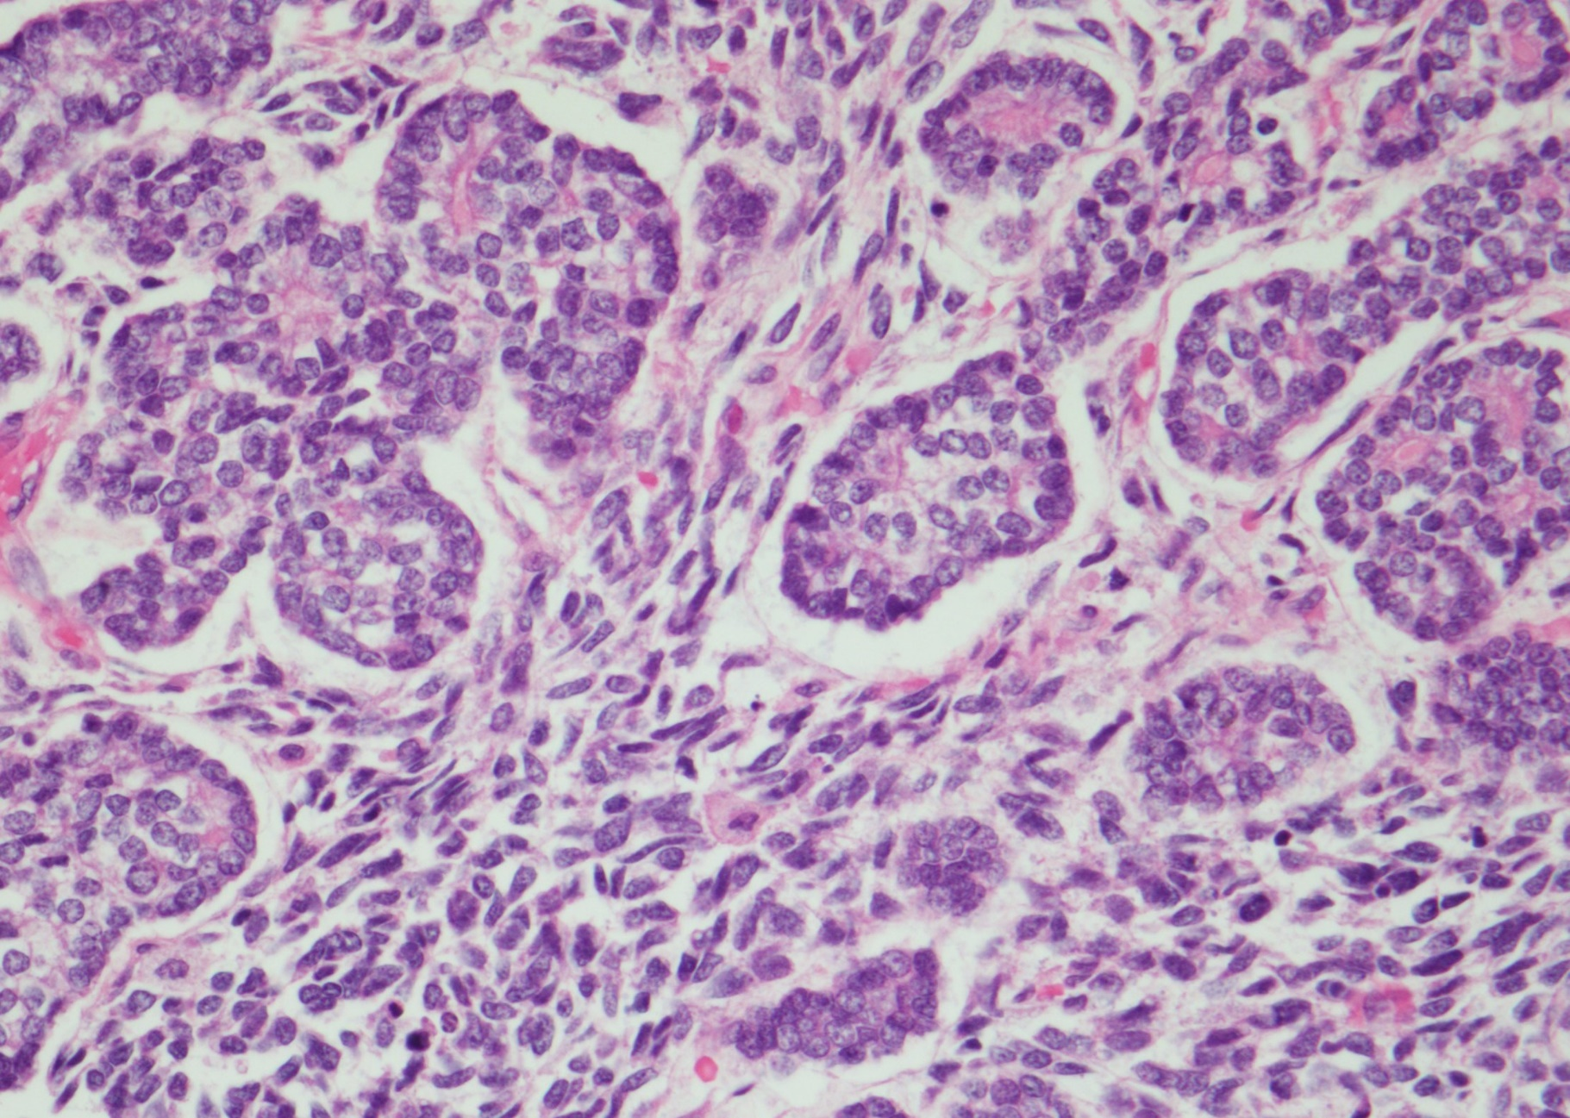
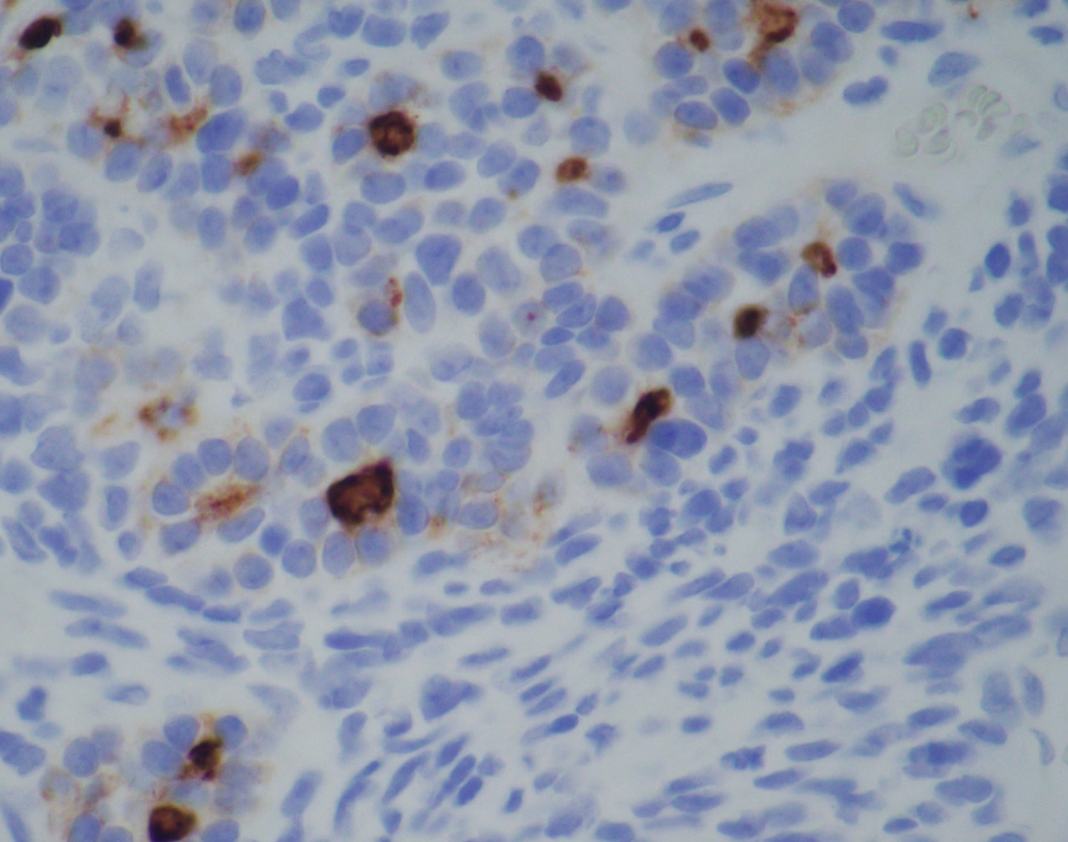
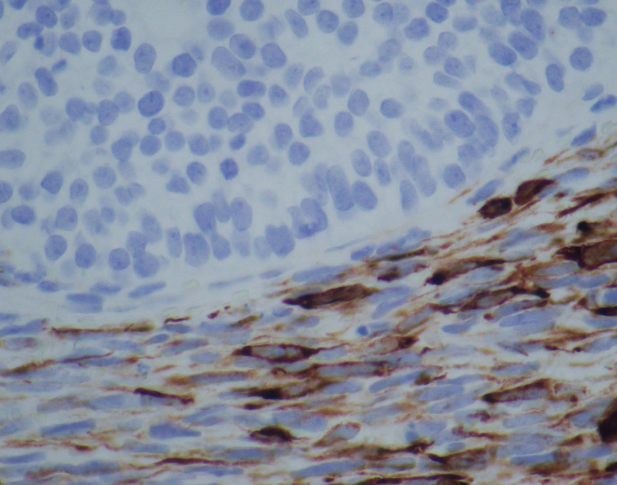
PAX8
Desmin
Thyroglobulin

Slide 68
5th Edition WHO Classification of Endocrine and Neuroendocrine Tumors
As in all the WHO books in the 5th edition, mesenchymal and stromal tumors, hematolymphoid neoplasms, germ cell tumors, and metastatic malignancies are discussed separately

Slide 69
2022 WHO Endocrine And Neuroendocrine Tumors: Genetic Tumor Syndromes
1. Multiple endocrine neoplasia type 1
2. Multiple endocrine neoplasia type 2
3. Multiple endocrine neoplasia type 4
4. Multiple endocrine neoplasia type 5 (MAX related tumours)
5.Hyperparathyroidism jaw tumour syndrome
6. Von Hippel Lindau syndrome
7. SDH deficient tumour syndrome
8. Neurofibromatosis type 1
9. Carney complex
10. McCune Albright syndrome
11. DICER1 syndrome
12. Glucagon cell hyperplasia and neoplasia
13. MAFA related familial insulinomatosis
14. Syndromic familial follicular cell-derived thyroid tumours
15. Non-syndromic familial follicular cell-derived thyroid tumours

Slide 70
The major updates in thyroid pathology tumor classification by the who 5th edition
Vania Nosé, MD, PhD
vnose@mgh.harvard.edu

Slide 71
obrigadA!

